Slide 1
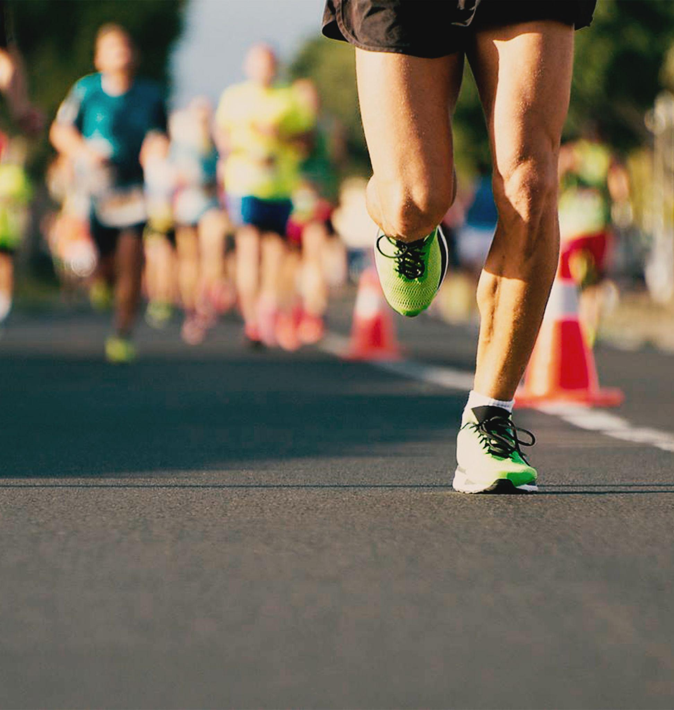

FINAL PRESENTATION AND DEMO
HCI - Assignment N.2
Design and prototyping of an application
using a human-centered approach
Project Title: User Adapted Running App
Group: Gonçalo Aguiar, Miguel Ferreira & João Figueiredo
Lab Class: P1

Slide 2
INTRODUCTION
HCI - Assignment N.2
We chose a running/walking application focused on motivating the user because we think that the running applications that already exist are too focused on providing feedback
The main difference in our application is that we can participate in group activities and activity goals that are adapted to the user.
User Adapted Running App

Slide 3
PROJECT OBJECTIVES
WHAT ARE THE EXPECTED OUTCOMES?
WHAT ARE THE BENEFITS?
HCI - Assignment N.2
Make a more user friendly running app.
User’s can create and participate in group activities.
The app motivates user’s through medals and feedback.
Promote group activities and socializing while exercising.
Make exercise more accessible and more captivating.
User Adapted Running App

Slide 4
Methodology
A ALTERA A DISPOSIÇÃO
We used User-Centered Requirement approach to create our application by creating Personas and Scenarios
We created created two prototypes and tested them with real users in order to improve our application.
User Adapted Running App

Slide 5
PERSONAS
MARIA ADRIANA
JOSÉ FONTES
HCI - Assignment N.2
FEMALE, 72, RETIRED
MALE, 29, SHOPKEEPER
Has two daughters.
Former women’s hairdresser.
Walks everyday, checks heart rate and calories but thinks that her usual application is hard to use.
Since she was used to not be alone she would like to some company for her walks.
Lives with his wife and son.
Trains everyday for marathons.
Amateur runner that checks detailed aspects of the run and compares with previous results.
User Adapted Running App

Slide 6
SCENARIOS
SCENARIO 1
SCENARIO 2
HCI - Assignment N.2
Maria Adriana decides to go for a walk and activates the system when she leaves her house. Later, she meets another woman that was also going for a walk and they make a ‘group’ so next time they can walk together.
When Maria Adriana stops walking she proceeds to deactivate the system and checks the information about her walk.
José Fontes decides to go for a run and activates the system when he starts running.
While he is running he decides to check the kms he already did.
When he stops running he proceeds to deactivate the system and checks the information about his run and if he won a medal.
User Adapted Running App

Slide 7
TASKS
HCI - Assignment N.2
SCENARIO 1
SCENARIO 2
Initiate the application
Choose between run/walk
Press start
Press pause
Create group and invite friend
Press resume
Press end activity and check feedback
Initiate the application
Choose between run/walk
Press start
Press more info
Press end
Press profile and check medals
User Adapted Running App

Slide 8
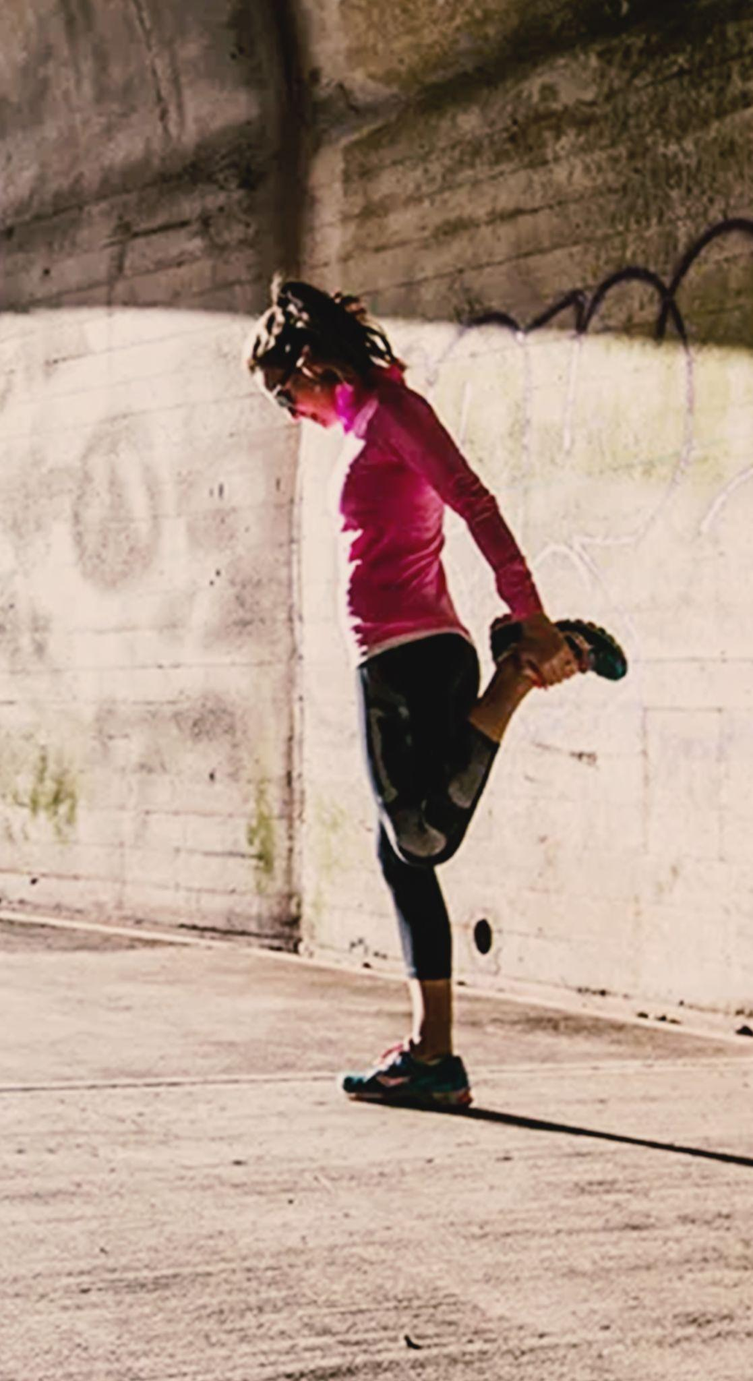
REQUIREMENTS
FUNCTIONAL
NON-FUNCTIONAL
HCI - Assignment N.2
Record, analyse and give feedback about the user’s exercise.
GPS connection.
Bluetooth connection to the fitness tracker.
Real time tracking.
User Profile.
Groups.
Registration and Login.
Easy to learn.
Simple interface.
App should load fast.
User Adapted Running App

Slide 9
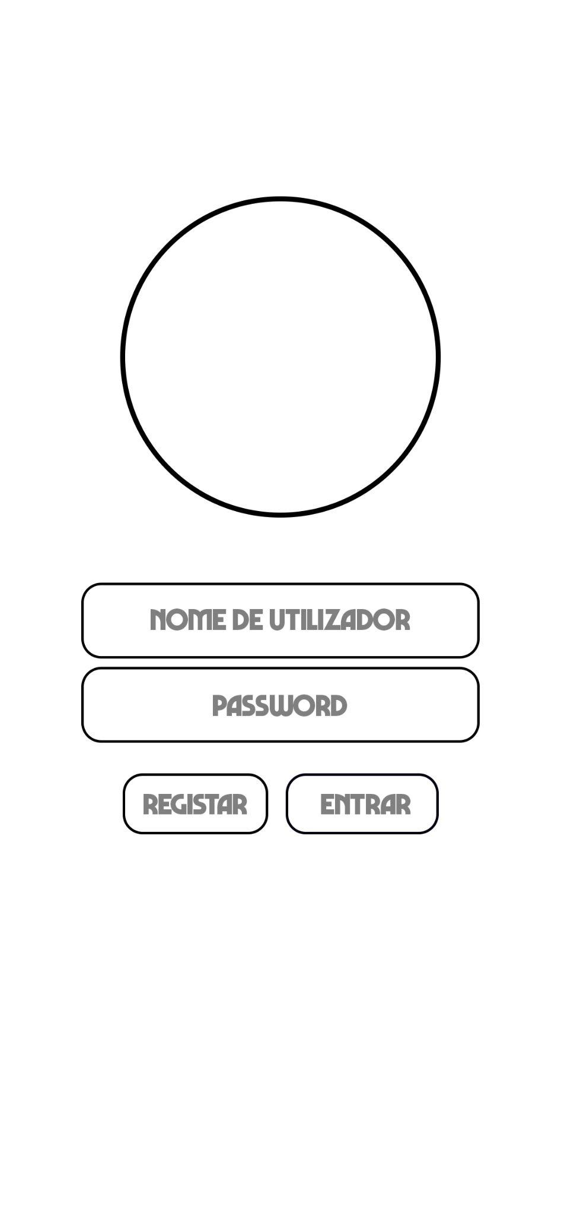
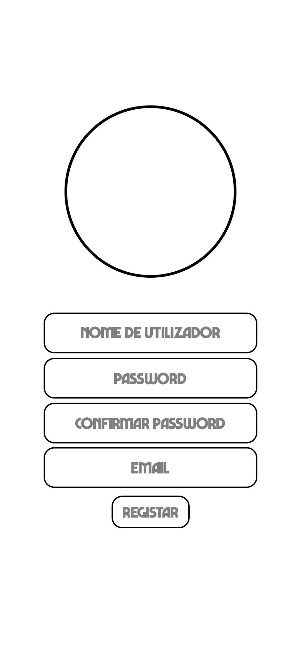
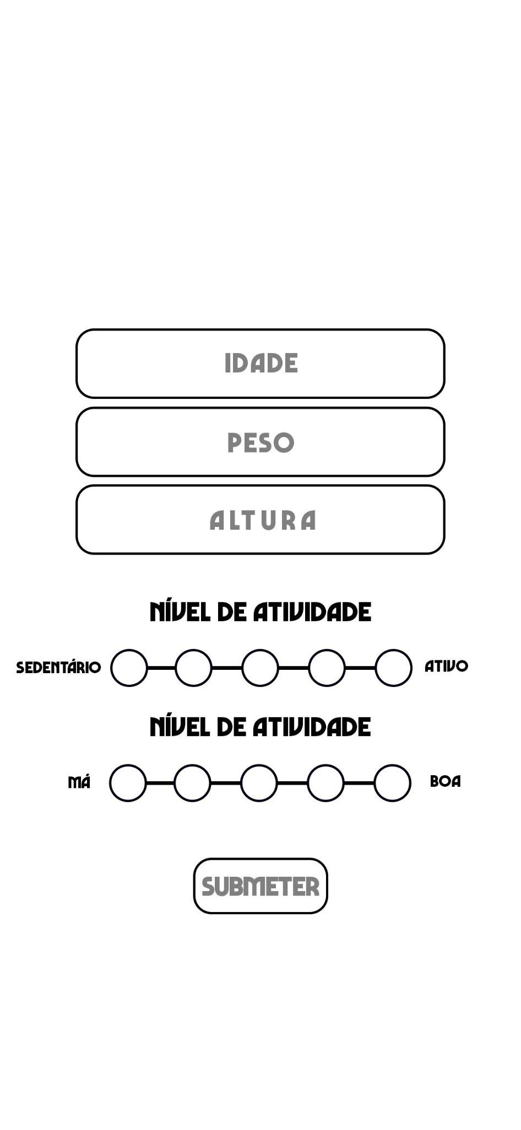
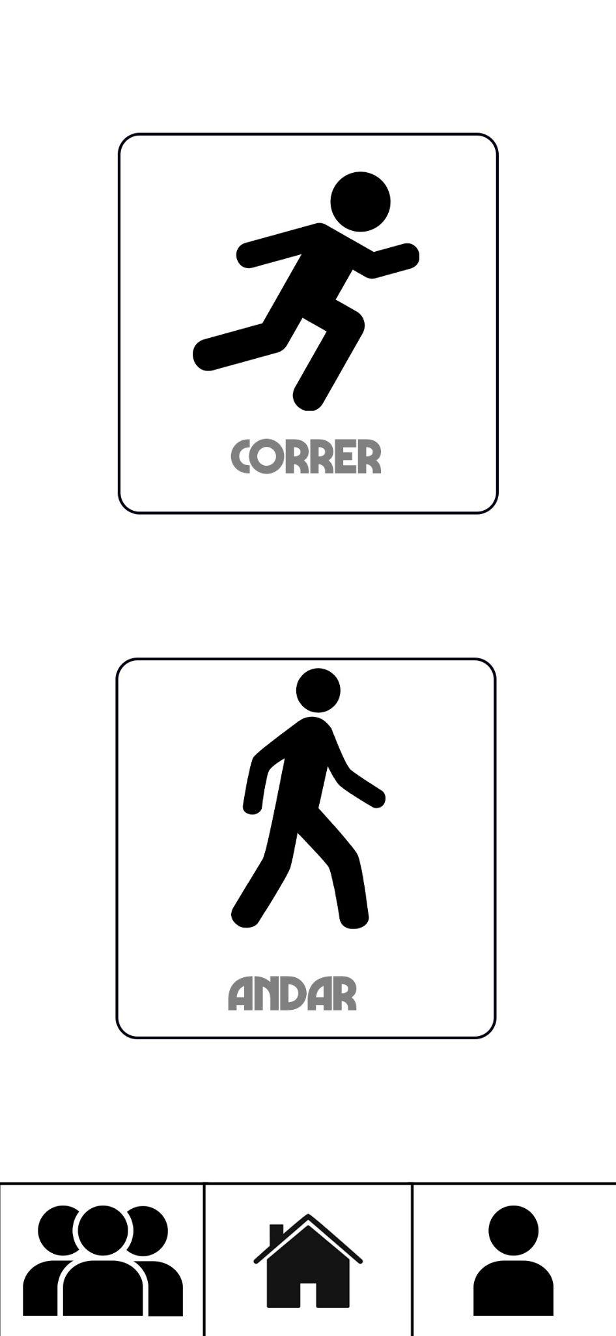
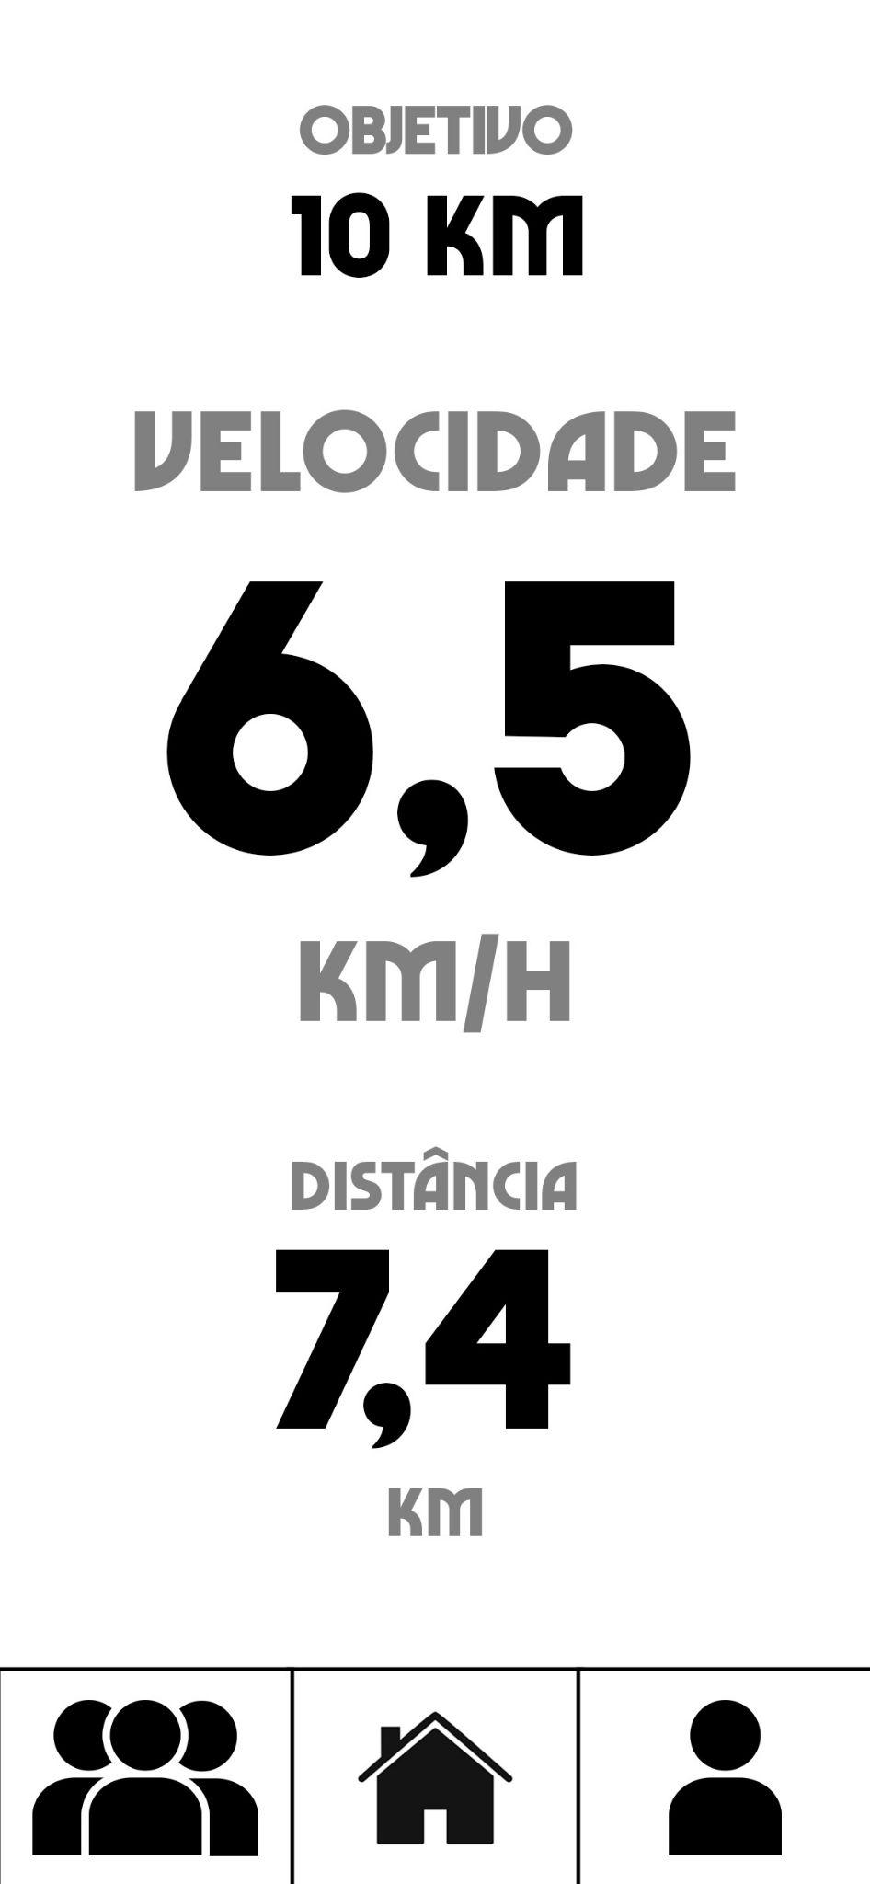
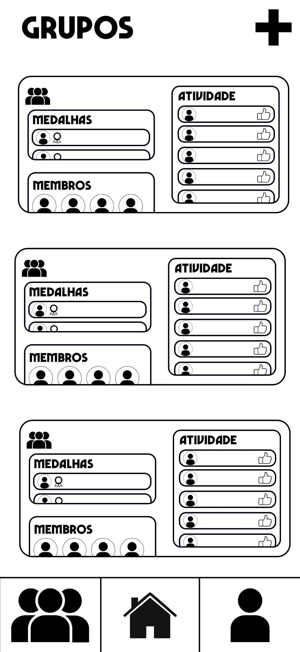
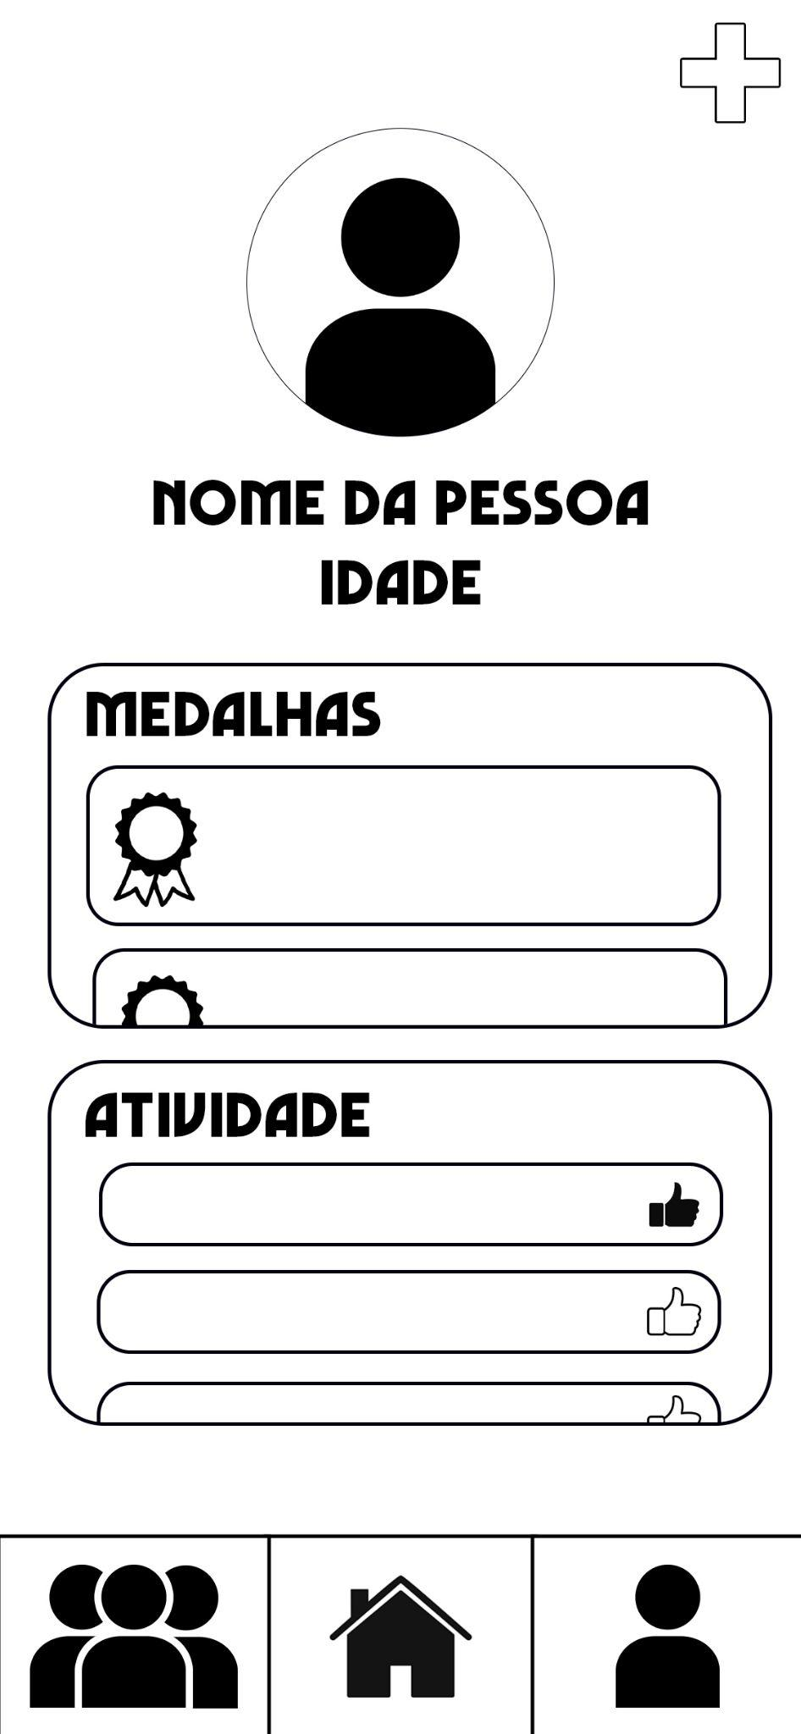
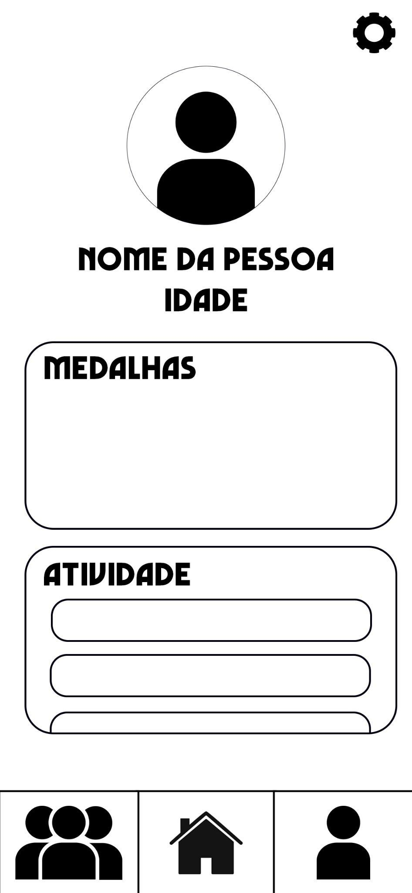
LOW FIDELITY PROTOTYPE
HCI - Assignment N.2
Goal : Evaluate the system usability
We implemented a Digitally Drawn Paper Prototype
User Adapted Running App

Slide 10
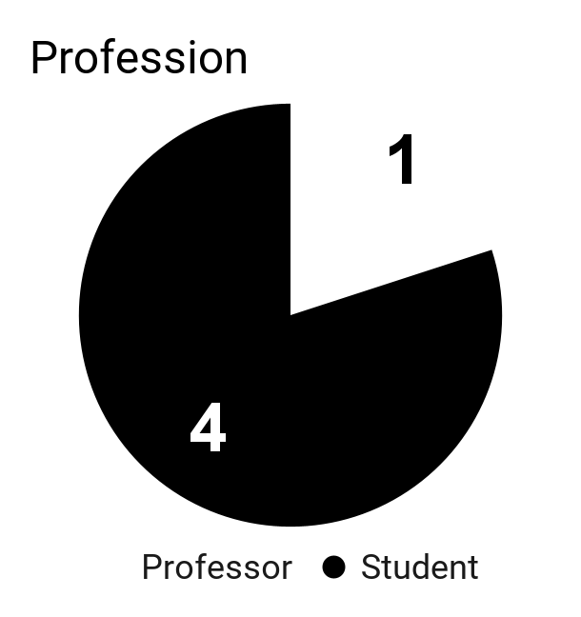
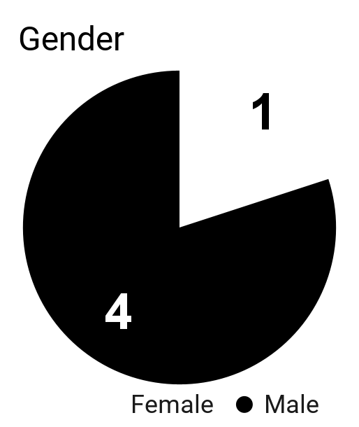
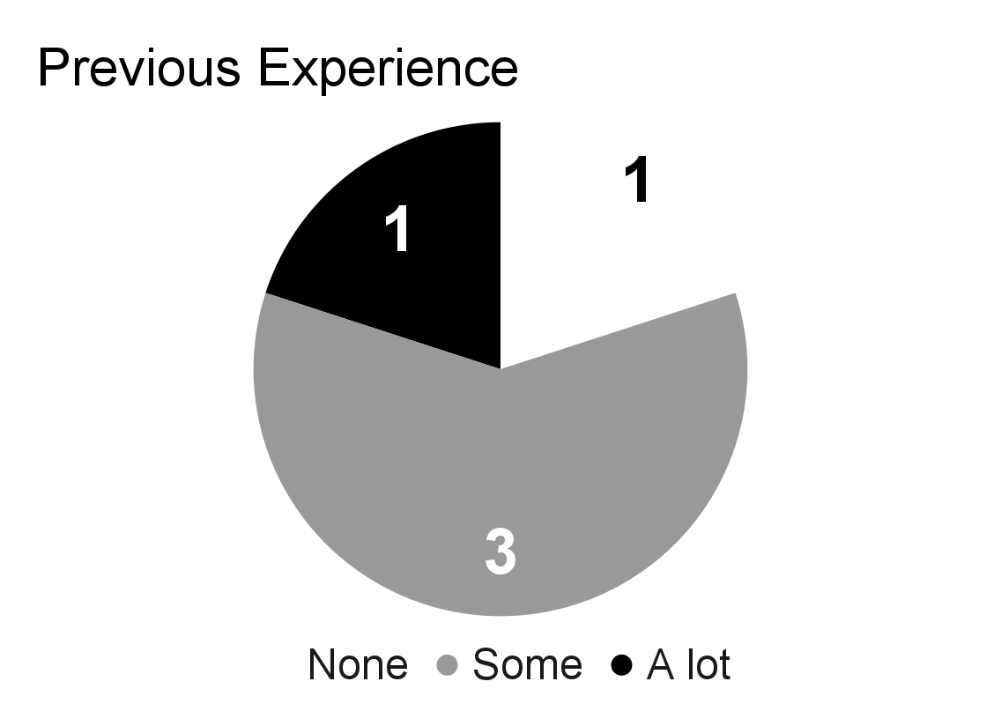
LFP - PARTICIPANT PROFILES
Participants : 5 —> Median age: 21
HCI - Assignment N.2
User Adapted Running App

Slide 11
LFP USER EVALUATION
HCI - Assignment N.2
TASKS | TEST 1 | TEST 2 | TEST 3 | TEST 4 | TEST 5
1 - Register in the App | 5 | 5 | 5 | 5 | 5
2 - Fill out initial questionnaire | 5 | 5 | 5 | 5 | 5
3 - Perform an activity (Run or Walk) | 5 | 5 | 5 | 5 | 5
4 - Create a Group | 5 | 4 | 3 | 4 | 5
5 - See a profile | 5 | 5 | 5 | 5 | 5
Very Difficult 1-2-3-4-5 Very Easy
User Adapted Running App

Slide 12
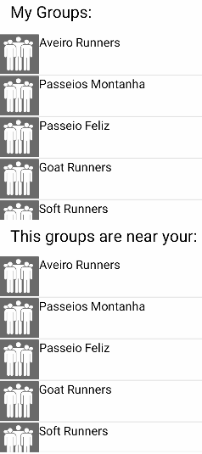
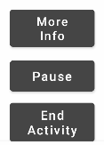
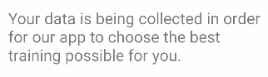
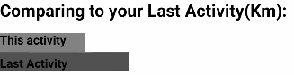
LFP- MAIN RESULTS
HCI - Assignment N.2
Add buttons to stop, resume, pause activity and check more information
Change the groups display (add my groups and groups near me)
Add why we are asking for the user info in the initial questionnaire
Add a way of comparing the present activity with the last one done with a bar p.e.
Changed the info displayed in the main page
User Adapted Running App

Slide 13
FUNCTIONAL PROTOTYPE
Goal: Evaluate the system usability
HCI - Assignment N.2
Tasks:
Register in the app and fill the initial questionnaire
Initiate a running activity and check the route in the map
Create a group and create a group activity for that group
Invite a person for one of your groups
Check your last activities and say how many running activities you already did
In the group Aveiro Runners check how many medals has Fred232.
User Adapted Running App

Slide 14
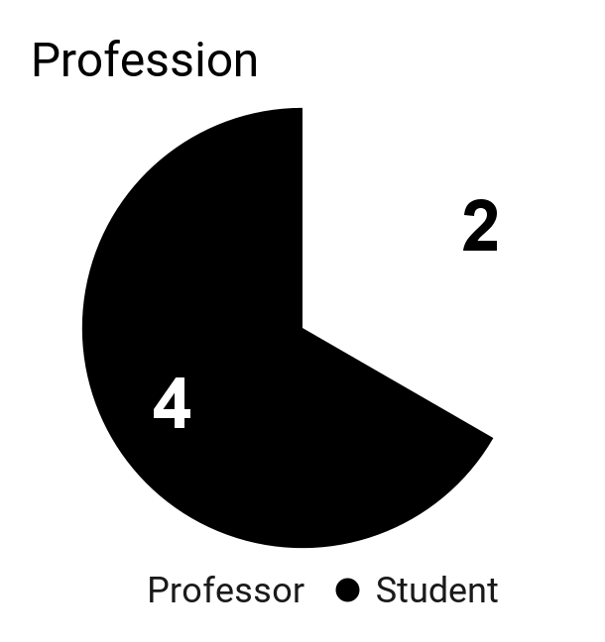
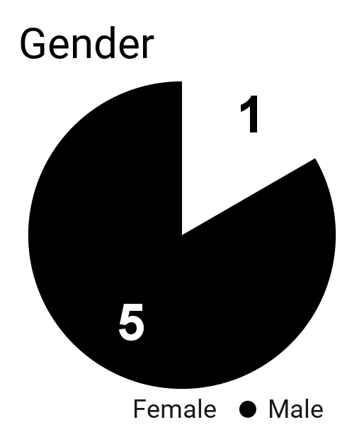
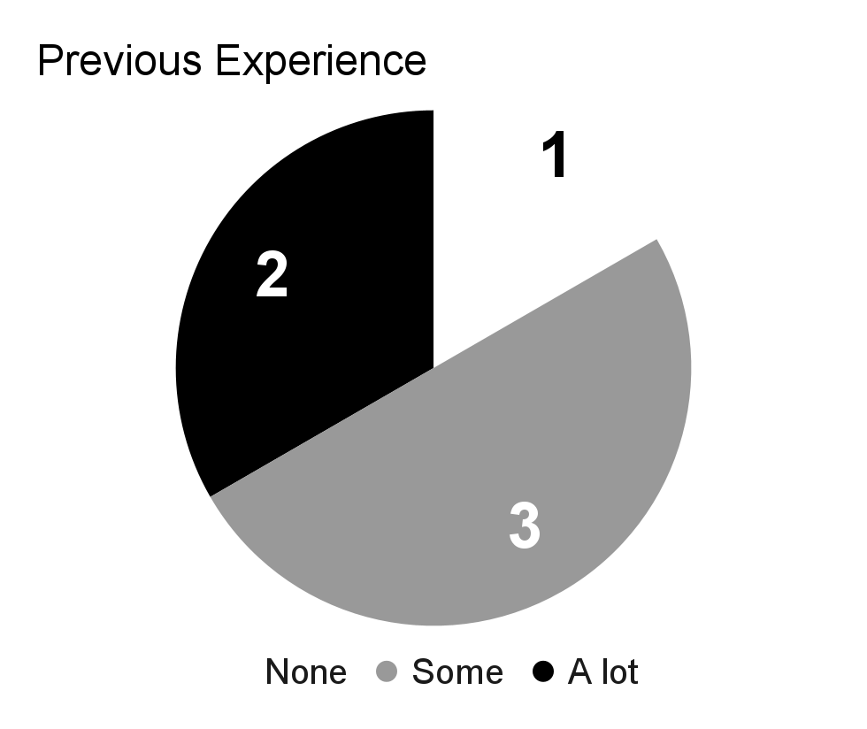
FUNCTIONAL PROTOTYPE - PARTICIPANT PROFILES
Participants : 6 —> Median age: 21
HCI - Assignment N.2
User Adapted Running App

Slide 15
Functional Prototype User Evaluation
HCI - Assignment N.2
TASKS | TEST 1 | TEST 2 | TEST 3 | TEST 4 | TEST 5 | TEST 6
Task 1 | 5 | 5 | 5 | 5 | 5 | 5
Task 2 | 5 | 4 | 4 | 5 | 5 | 4
Task 3 | 5 | 4 | 4 | 5 | 5 | 4
Task 4 | 5 | 5 | 5 | 5 | 5 | 5
Task 5 | 5 | 5 | 5 | 5 | 5 | 5
Task 6 | 5 | 5 | 5 | 5 | 5 | 5
Very Difficult 1-2-3-4-5 Very Easy
User Adapted Running App

Slide 16
POST TASK QUESTIONNAIRE
System Usability Score(SUS): 71,2
HCI - Assignment N.2
I think that I would like to use this system frequently
I found the system unnecessarily complex
I thought the system was easy to use
I think that I would need the support of a technical person to be able to use this system
I found the various functions in this system were well integrated
I thought there was too much inconsistency in this system
I would imagine that most people would learn to use this system very quickly
I found the system very cumbersome to use
I felt very confident using the system
I needed to learn a lot of things before I could get going with this system
User Adapted Running App

Slide 17
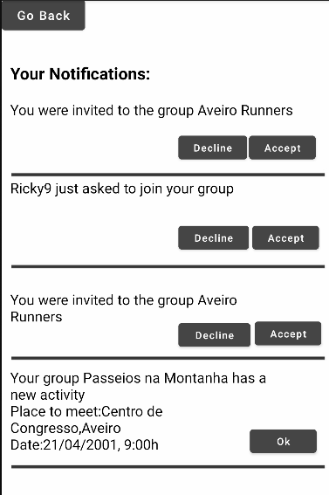


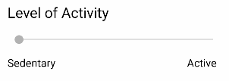
FUNCTIONAL PROTOTYPE- MAIN RESULTS
HCI - Assignment N.2
Add ‘run’/’walk’ subtitles under the icons
Change the ‘run’ and ‘walk’ icon buttons
Add go back buttons in all pages without the navigation bar.
Merge the two activity bars in the initial questionnaire into one.
Add a notifications page so the user receives invites to groups and group activities
Request to join button in the groups near me
User Adapted Running App

Slide 18
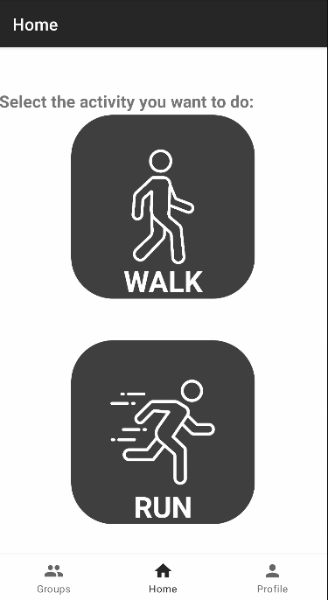


PLATFORM USED FOR THE FUNCTIONAL PROTOTYPE
ANDROID STUDIO
GITHUB
HCI - Assignment N.2
We used Java and XML to define the behaviour and look of the app.
We used git to control the version of the app and to have a remote copy of the project.
User Adapted Running App

Slide 19
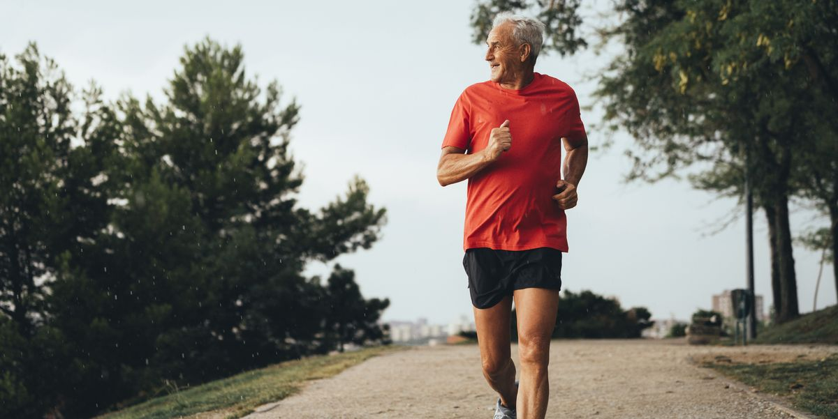
HCI - Assignment N.2
DEMO
User Adapted Running App

Slide 20
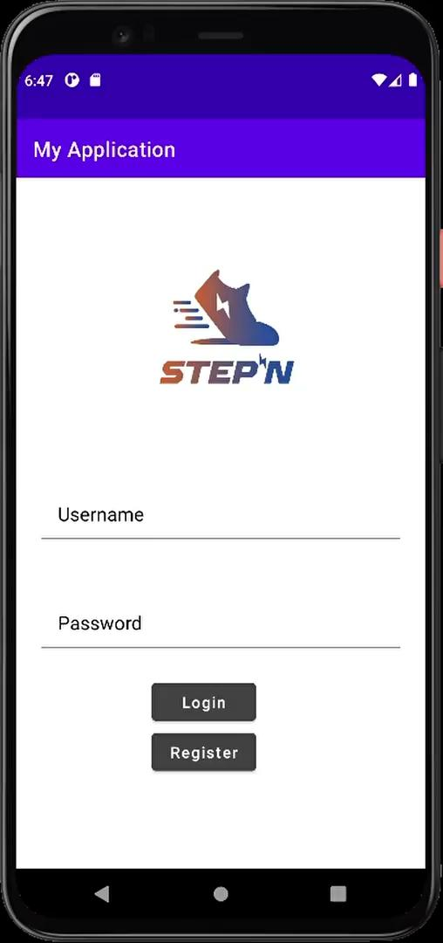

HCI - Assignment N.2
Register
Fill the questionnaire
Initiate run
Check more info
Login
Invite friend to a group
Check notifications
Check one of the last activities
User Adapted Running App

Slide 21

HCI - Assignment N.2
Request to join in a group near me
Visit a profile from a user that belongs to a group near you
Create a group
Create a activity in that group
User Adapted Running App

Slide 22
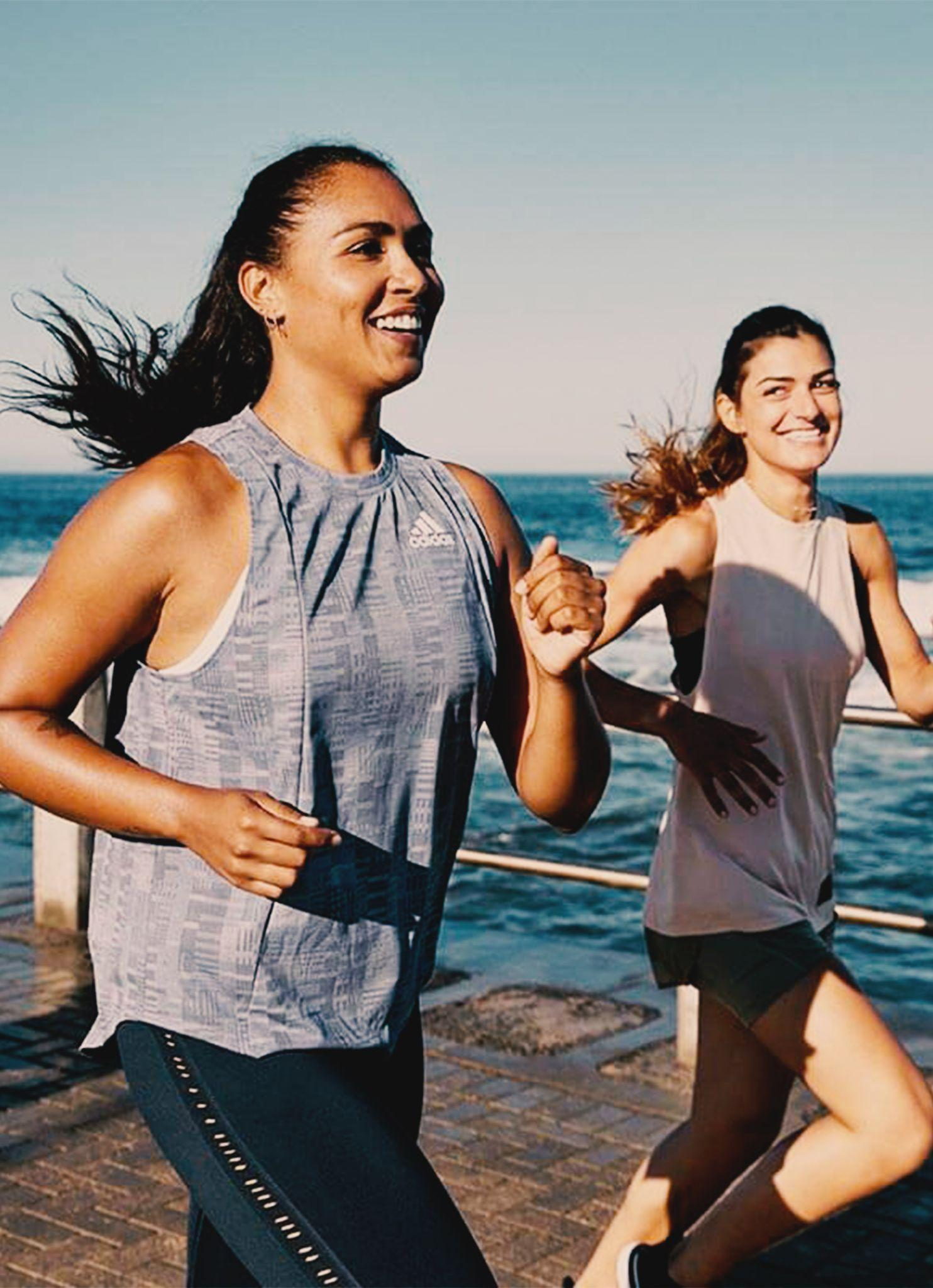
FUTURE WORK
BACKEND
IMPROVE DESIGN
QUESTIONS
HCI - Assignment N.2
DEVELOP THE BACKEND FEATURES FOR THE APP
IMPROVE EVEN MORE THE APP DESIGN BECAUSE THERE’S ALWAYS SOMETHING TO CHANGE.
IF YOU HAVE ANY QUESTIONS, NOW IS THE TIME.
User Adapted Running App

